Slide 1
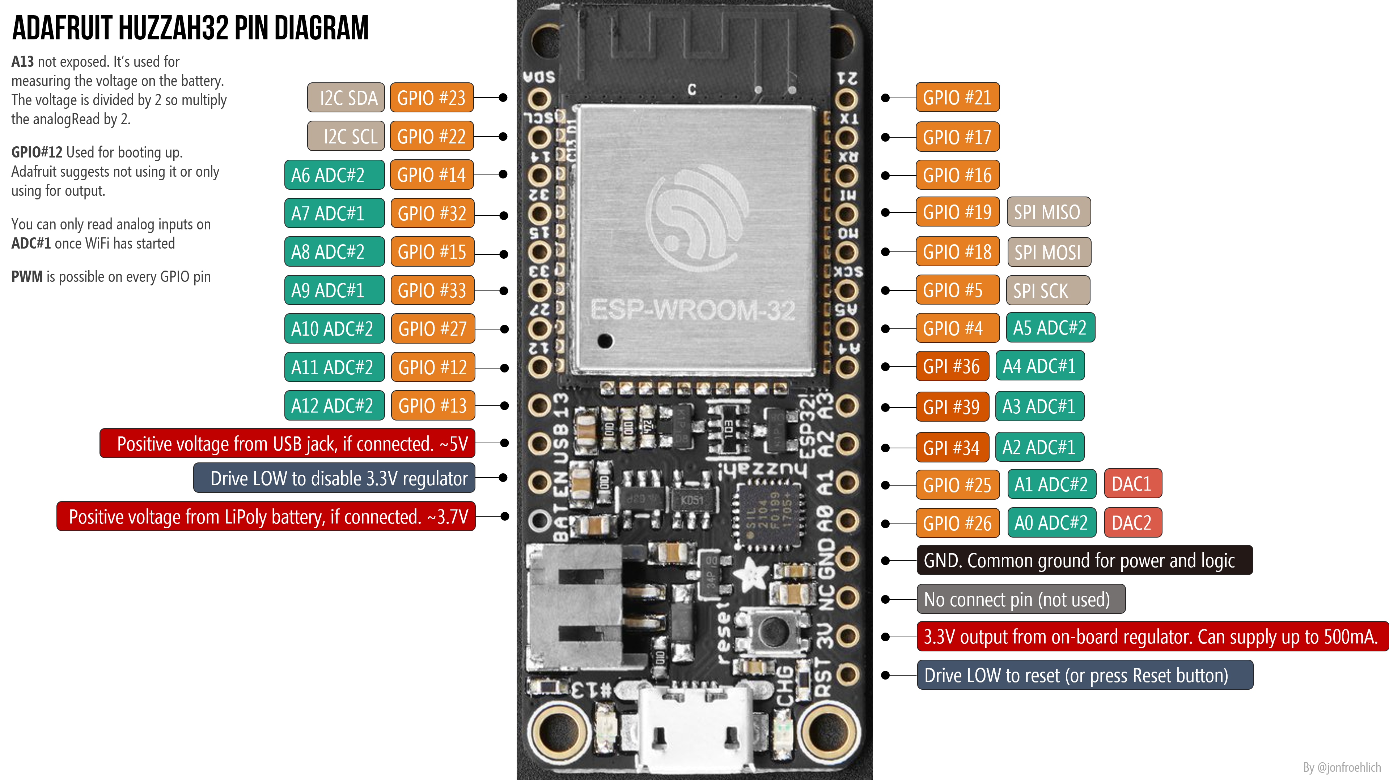
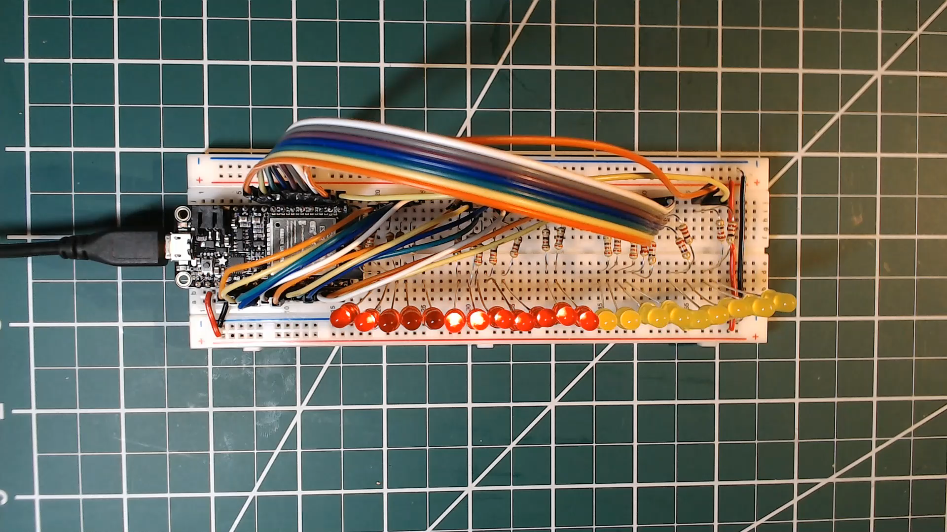
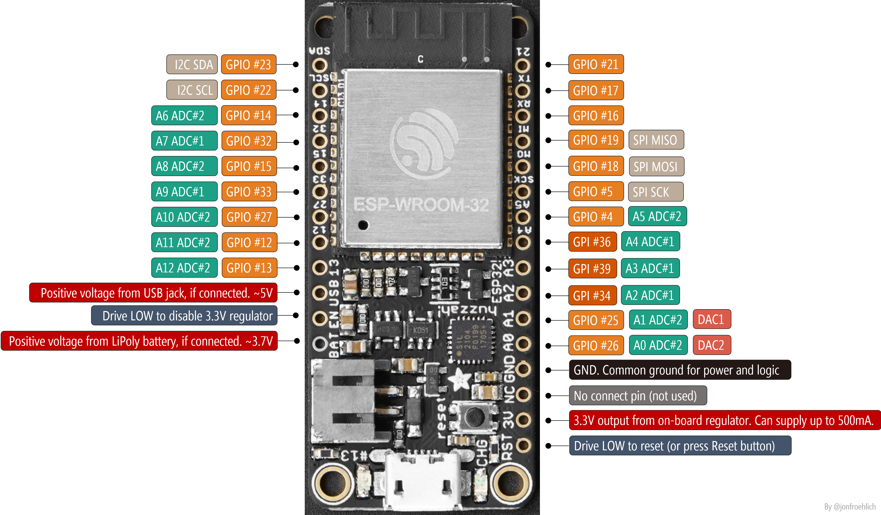
GPIO #13
GPIO #12
GPIO #27
GPIO #33
GPIO #15
GPIO #32
GPIO #14
GPIO #22
GPI #34
GPIO #23
GPI #39
GPIO #26
GPI #36
GPIO #25
GPIO #4
GPIO #5
GPIO #18
GPIO #19
GPIO #16
GPIO #17
GPIO #21

Slide 2
GPIO #13
GPIO #12
GPIO #27
GPIO #33
GPIO #15
GPIO #32
GPIO #14
GPIO #22
GPI #34
GPIO #23
GPI #39
GPIO #26
GPI #36
GPIO #25
GPIO #4
GPIO #5
GPIO #18
GPIO #19
GPIO #16
GPIO #17
GPIO #21

